Slide 1
Environment and Theoretical Structure of Financial Accounting
Chapter 1

Slide 2
Financial Accounting Environment
Part I

Slide 3

The first step in understanding the current and future states of financial reporting is to how we got here.

Slide 4

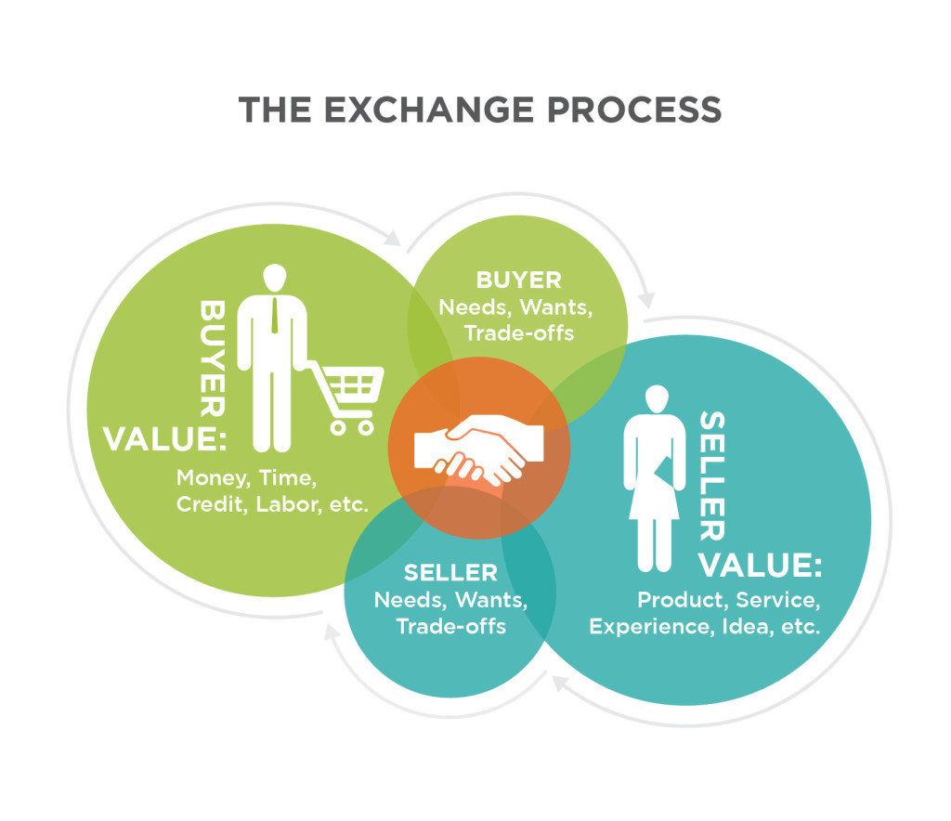
A (very) Brief History of Accounting
Arms’-length exchange

Slide 5

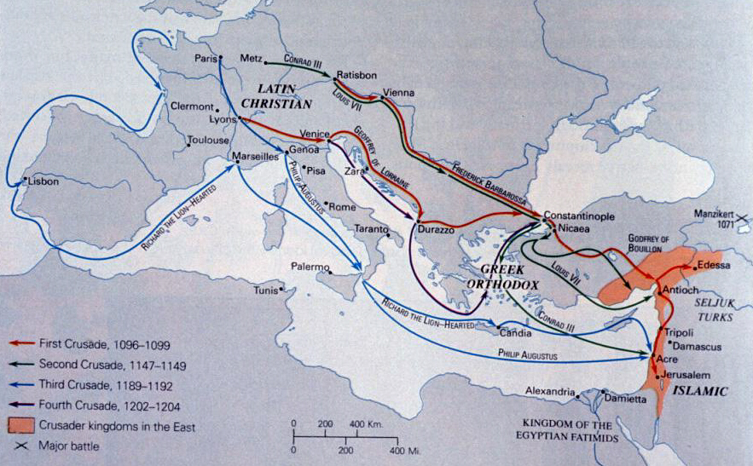

Crusades

Slide 6
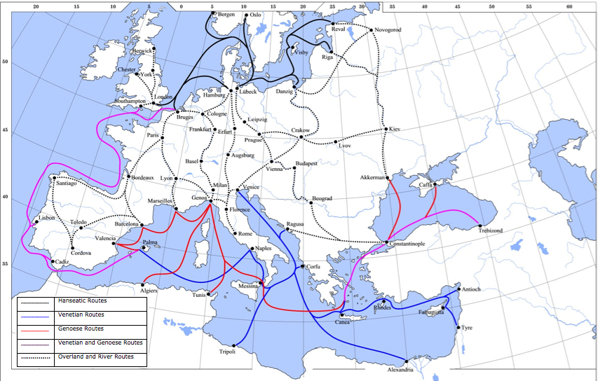
Commercial Trade Routes

Slide 7


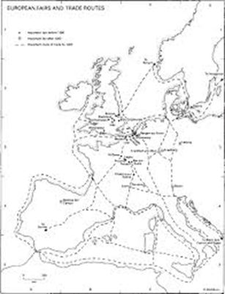
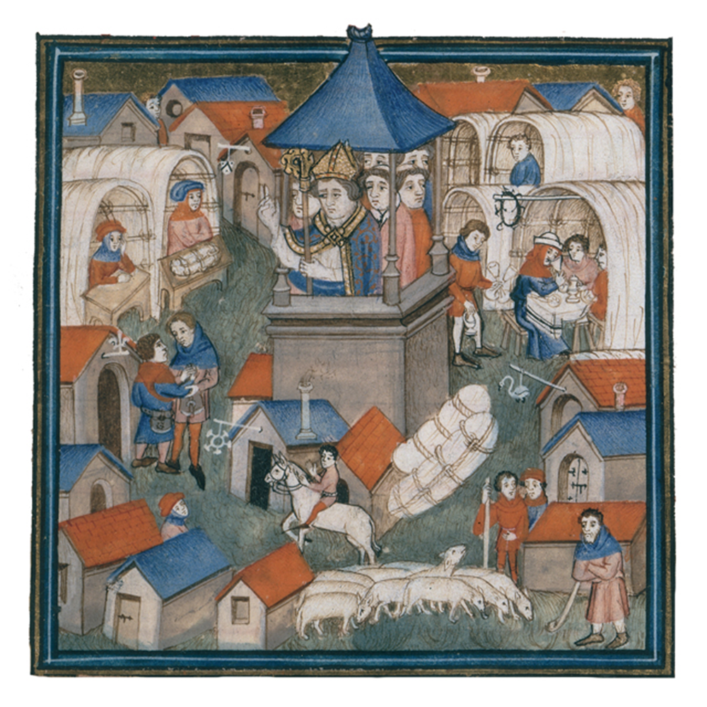
ChampagneFair

Slide 8





Markets

Slide 9

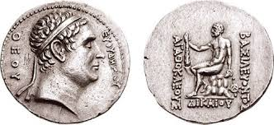

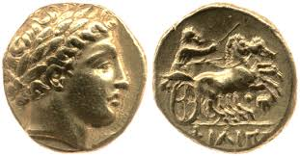
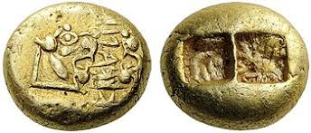

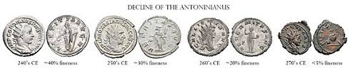
Coinage (an encumbrance and a liability)

Slide 10
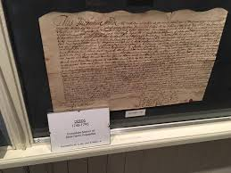
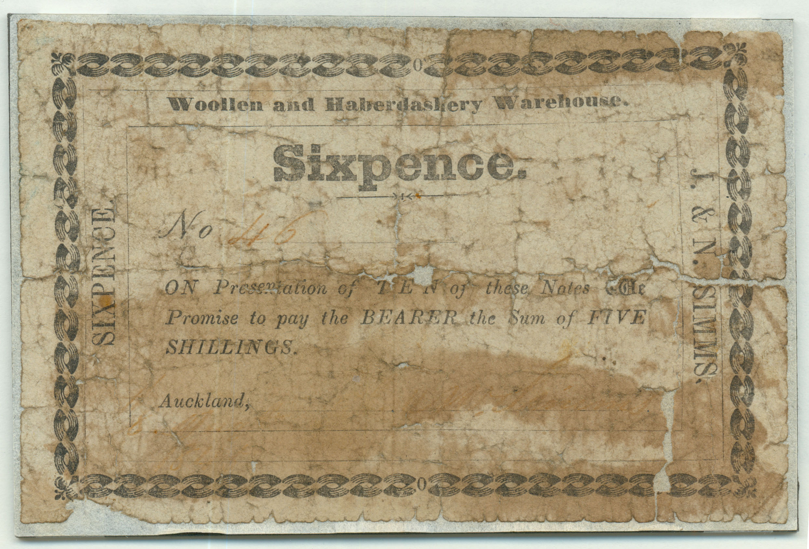

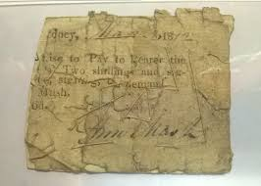
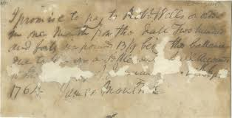
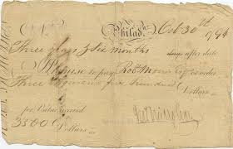
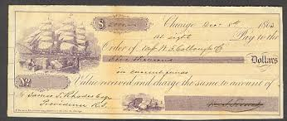
Promissory Notes
-Checks
-Accounts Receivable
-Accounts Payable

Slide 11

Lucio Pacioli – The “Father of Accounting
Summa de arithmetica, geometria, proportioni et proportionality (Venice: 1494)
Accounting cycle
  Journals
  Ledgers
  Assets
  Liabilities
  Capital
  Income
  Expenses
Closing entries
Trial balance
Accounting ethics
Cost accounting
“…a person should not sleep at night until the debits equal the credits.”

Slide 12




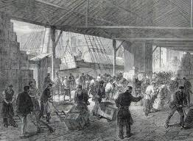
East India Trading Company
December 31, 1600
Queen Elizabeth I
Multiple investors
Agents acting on behalf of the company
Monopoly and control
Administrative burdens
Dissolved in 1874 after the India Rebellion
Notes:
In my opinion, this was the first real corporation. Multiple investors. Non-investor management.
1874 last dividend

Slide 13
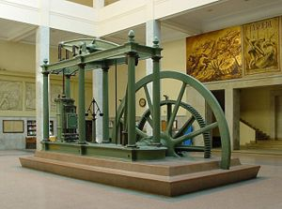
Steam Engine: 18th Century
James Watt
Notes:
The steam engine changed everything.

Slide 14
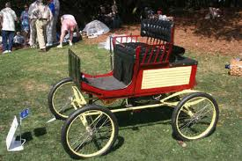

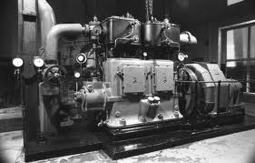
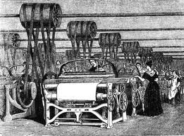
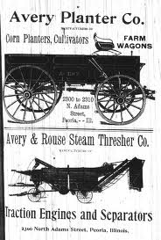
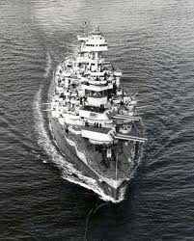
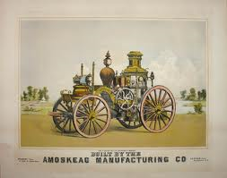
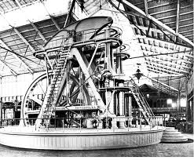
James Watt - 1794

Slide 15




Industrial Revolution
1760-1840 (in Europe)

Slide 16
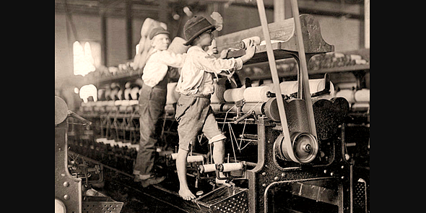
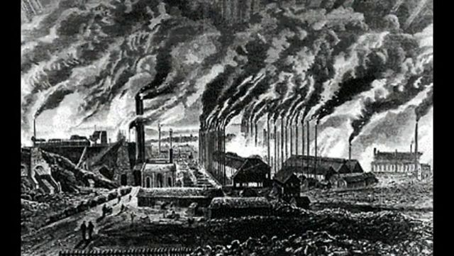
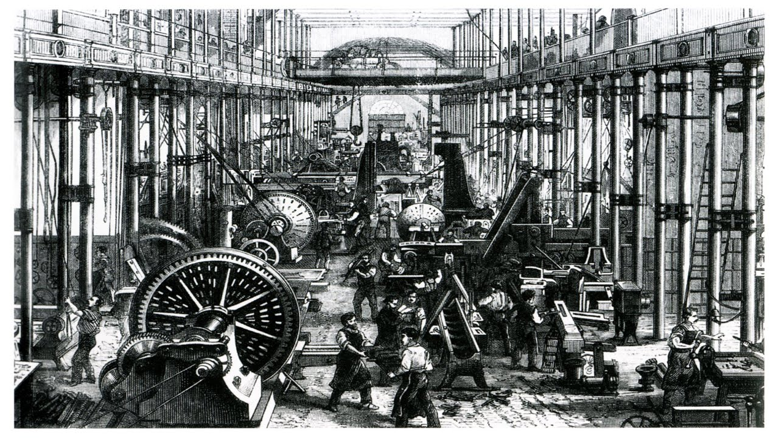
Industrial Revolution

Slide 17
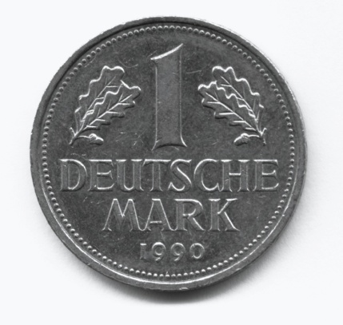


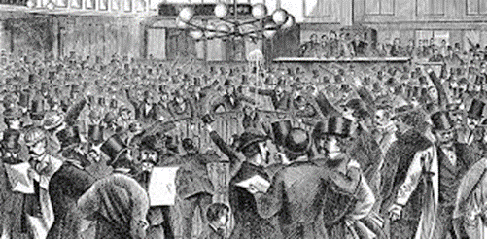



Need for Capital

Slide 18

Need for Management

Slide 19


Non-Owner Management Takes-Off

Slide 20
Economic Environment
The capital markets provide a mechanism to help our economy allocate resources efficiently

Slide 21
Economic Environment
The capital markets provide a mechanism to help our economy allocate resources efficiently
Corporations acquire capital from investors in exchange for ownership interest and by borrowing from creditors.

Slide 22
Economic Environment
Investors are betting on a return from their investment.

Slide 23

Agency/Contract Theory

Slide 24
Function & Primary Purpose of Financial Reporting
The primary focus of financial accounting is on the information needs of investors and creditors

Slide 25
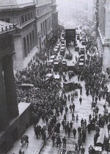
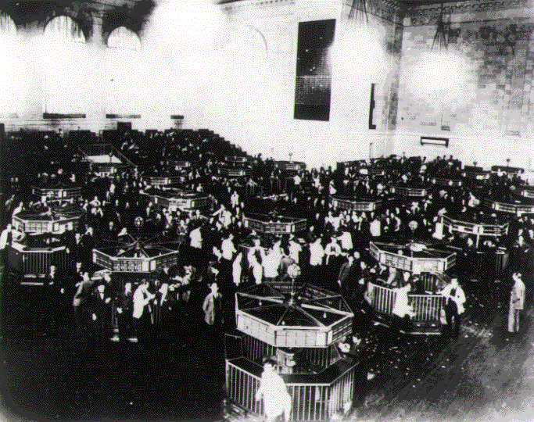
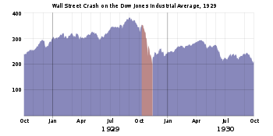
Stock Market Crash of 1929

Slide 26

Development of Financial Accounting & Reporting Standards
1933 and 1934
  The Securities and Exchange Commission (SEC) has the authority to set accounting standards for companies, but has always delegated the task to the accounting profession.

Slide 27
Hierarchy of Standard-Setting Authority
Congress
SEC
Private Sector
CAP
APB
FASB

Slide 28


Committee on Accounting Procedure (CAP)
1938-1959
Accounting Research Bulletins (51)
Goals
  For accounting to be self-governing
  To address problems common across registrants
Downfall:
  No conceptual framework
  Problem-based: too specific for the capital markets

Slide 29



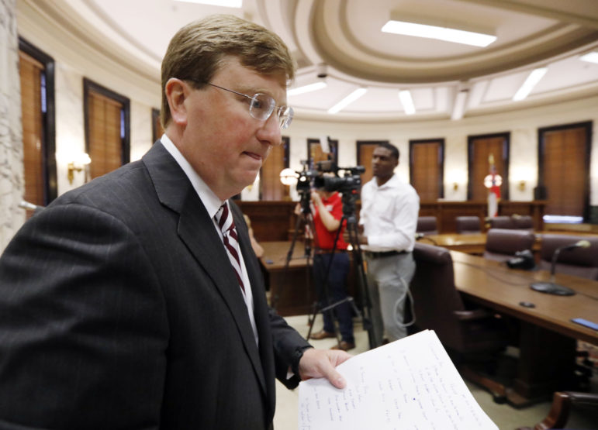

Accounting Principles Board (APB)
1959-1973
APB Opinions (31)
Interpretations
Statements (4)
Goals
  Advance the written expression of accounting principles
  Determine appropriate practices
  Narrow the areas of difference and inconsistency in practice
Downfall
  No conceptual framework
  No outside input
  Lack of productivity (voluntary members)
  Lack of independence (clients of board members)
  Government interference (lobbyists)
APB

Slide 30

Wheat Committee (1972)
Recommendations for reformatting the APB
Avoid government rule-making for accounting

Slide 31


Wheat Committee - Results
¹⁹⁷²
Financial Accounting Foundation
  Oversight
  Selects members of the Board
  Funding
Financial Accounting Standards Board
  Seven full-time members
  Various accounting constituencies
Financial Accounting Standards Advisory Council
  Projects & project priorities
  Agenda
  Procedural maters
and improved!

Slide 32
The Establishment of Accounting Standards (a political process)
A standard setter must consider potential economic consequences of accounting standards.

Slide 33
The Establishment of Accounting Standards (a political process)
A standard setter must consider potential economic consequences of accounting standards.
The FASB undertakes a series of information gathering steps before issuing a substantive accounting standard.

Slide 34
The Establishment of Accounting Standards (a political process)
A standard setter must consider potential economic consequences of accounting standards.
The FASB undertakes a series of information gathering steps before issuing a substantive accounting standard.
In the past, various interest groups have successfully lobbied standard setter for changes in standards involving such topics as accounting for stock-based compensation, business combinations, and other-than-temporary impairments of investments.

Slide 35
The Establishment of Accounting Standards (a political process)
A standard setter must consider potential economic consequences of accounting standards.
The FASB undertakes a series of information gathering steps before issuing a substantive accounting standard.
In the past, various interest groups have successfully lobbied standard setter for changes in standards involving such topics as accounting for stock-based compensation, business combinations, and other-than-temporary impairments of investments.
Political pressures on IASB standard setting are severe, with important groups like the EU threatening to “carve out” aspects of standards that they view as undesirable.

Slide 36
FASB Pronouncements
Standards, Interpretations, and Staff Positions
Financial Accounting Concepts
Emerging Issues Task Force Statements
GAAP

Slide 37
FASB Pronouncements
Standards, Interpretations, and Staff Positions
Financial Accounting Concepts
Emerging Issues Task Force Statements
GAAP
  Generally accepted accounting principles (GAAP) are a set of guidelines companies follow in measuring and reporting financial information.

Slide 38


FASB Pronouncements
Standards, Interpretations, and Staff Positions
Financial Accounting Concepts
Emerging Issues Task Force Statements

Slide 39


FASB Pronouncements
Standards, Interpretations, and Staff Positions
Financial Accounting Concepts
Emerging Issues Task Force Statements
  Narrow issues
  Speeds up approval process
  Looks for new issues

Slide 40

Accounting Standards Codification - 2009
ASU Number | Category
100 | General
200 | Presentation
300 | Assets
400 | Liabilities
500 | Stockholders’ Equity
600 | Revenue
700 | Expenses
800 | Wide Scope
900 | Industry
December 31, 2009
GAAP
On FASB website
Login name and password under Introductory Material on Blackboard
*ASU – Accounting Standards Update

Slide 41





Scandals
Auditors offer credibility to financial statements by verifying that they are presented fairly in conformity with GAAP.
Enron
WorldCom
Tyco
Waste Management

Slide 42


A New Age of Internal Control
2002
Sarbanes-Oxley (SOX) -2002
SOX provides for the
  Regulation of auditors and the types of services they furnish to clients,
  Increases accountability of corporate executives,
  Addresses conflicts of interest for securities analysts, and
  Provides for stiff criminal penalties for violators.

Slide 43

A New Age of Internal Control
2002
Sarbanes-Oxley (SOX)
PCAOB/AICPA (Public Company Accounting Oversight Board)

Slide 44

Cash and Accrual Accounting
Part II.

Slide 45
Function & Primary Purpose
The primary focus of financial accounting is on the information needs of investors and creditors
Financial statements convey financial information
  Balance sheet (statement of financial position)
  Income statement (statement of operations)
  Statement of cash flows
  Statement of shareholders’ equity
  Statement of comprehensive income
    Immediately following the income statement
    Separately, including information on the income statement as well as information on other

Slide 46
Cash versus Accrual Accounting
Cash | Accrual
Records transactions only when cash is received or paid (When client pays for product or service & when bills are paid) Only used by very small businesses Cannot match revenue against expenses in an accounting period | Records business transactions when they occur (When sale is made & when bill is received) Complies with GAAP (Generally Accepted Accounting Principles) Presents accurate financial picture

Slide 47
Cash versus Accrual Accounting
The investment/credit decision – a cash flow perspective
  A company will be able to provide a return to investors and creditors only if it can generate cash receipts from selling a product or service that exceed the cash disbursements necessary to provide that product or service.
  The objective of financial accounting is to provide information to investors and creditors to help them predict future cash flows.

Slide 48
Cash versus Accrual Accounting
  Over short periods of time, operating cash flow may not be an accurate predictor of future operating cash flows.
  The accrual accounting model provides a measure of periodic performance called net income.
  Net income is considered a better indicator of future operating cash flows than is current net operating cash flows.

Slide 49

International Financial Reporting Standards
Part III.

Slide 50
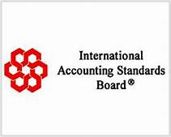
International Standard Setting
The International Accounting Standards Board (IASB) has responsibility for developing International Financial Reporting Standards (IFRS)

Slide 51
International Standard Setting
The International Accounting Standards Board (IASB) has responsibility for developing International Financial Reporting Standards (IFRS)
  In 2002, the FASB and IASB signed the Norwalk Agreement, pledging to remove existing differences between standards. Since then, both boards have been working toward convergence.

Slide 52
International Standard Setting
The International Accounting Standards Board (IASB) has responsibility for developing International Financial Reporting Standards (IFRS)
In July 2012, the SEC staff issues its Final Staff Report in which it concludes that it is not feasible for the U.S. to simply adopt IFRS, given
A need for the U.S. to have strong influence on the standard-setting process and ensure that standards meet U.S. needs.
The high costs to companies of converting to IFRS
The fact that many laws, regulations, and private contracts reference U.S. GAAP.

Slide 53

International Standard Setting
The bottom line:
IFRS: Principles-Based Accounting
GAAP: Rules-Based Accounting

Slide 54
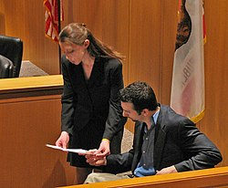
International Standard Setting
The bottom line:

Slide 55

Ethics in Accounting
Part IV.

Slide 56
Ethics in Accounting
Recent accounting scandals have rekindled the debate over principles-based, or more recently termed, objective-based, versus rules-based accounting standards. A principles-based approach to accounting standard setting stresses professional judgment. A rules-based approach stresses adherence to a set of rules.

Slide 57
Ethics in Accounting
Recent accounting scandals have rekindled the debate over principles-based, or more recently termed, objective-based, versus rules-based accounting standards. A principles-based approach to accounting standard setting stresses professional judgment. A rules-based approach stresses adherence to a set of rules.
Ethical judgment is critical in accounting, particularly if decisions are not specified by rules.
  Ethics deal with the ability to distinguish right from wrong.
  Many professions have articulated ethical standards in a code of ethics.
  There are a number of steps that provide a framework for analyzing ethical issues.

Slide 58

Conceptual Framework
Part V.

Slide 59
Conceptual Framework
What is the purpose of the FASB’s conceptual framework?

Slide 60
Conceptual Framework
The purpose of the conceptual framework is to guide the Board in developing accounting standards by providing an underlying foundation and basic reasoning on which to consider merits of alternatives.
The conceptual framework can be used in developing or updating existing standards.
The conceptual framework does not prescribe GAAP.

Slide 61
Conceptual Framework Standards
SFAC | Description | Status
SFAC 1 | Overall goal
SFAC 2 | Quantitative factors
SFAC 3 | Elements of financial statements
SFAC 4 | Government & not-for-profit
SFAC 5 | Measurement
SFAC 6 | Elements of financial statements
SFAC 7 | Recognition and measurement
SFAC 8 | Quantitative factors & overall goal

Slide 62
Conceptual Framework Standards
SFAC | Description | Status
SFAC 1 | Overall goal
SFAC 2 | Quantitative factors
SFAC 3 | Elements of financial statements
SFAC 4 | Government & not-for-profit | Active but irrelevant
SFAC 5 | Measurement | Active
SFAC 6 | Elements of financial statements | Active & Supplants SFAC 3
SFAC 7 | Recognition and measurement | Active
SFAC 8 | Quantitative factors & overall goal | Active & Supplants SFAC 1 & 2

Slide 63
SFAC 5 & 7
Assumptions
Principles
Economic entity
Going concern
Periodicity
Monetary unit
Revenue recognition
Expense recognition
Mixed-attribute measurement
Full disclosure

Slide 64
Financial Statements
Balance sheet
Income statement
Statement of comprehensive income
Statement of cash flows
Statement of shareholders’ equity
Related disclosures

Slide 65
Elements of Financial Statements (SFAC 6)
Balance Sheet
Income Statement
Assets
Liabilities
Equity
Investments by Owners
Distributions to Owners
Revenues
Expenses
Gains
Losses
Comprehensive Income

Slide 66
Gains and Losses
The sale of non-core assets
Book Value = Historical Cost – Accumulated Depreciation (updated to the date of sale)
Fair Value = the street value of the asset on the date of sale = what a knowledgeable person would pay for the asset on the date of the sale
Gain/<Loss> = Fair Value – Book Value
  If Book Value < Fair Value, Then Gain
  If Book Value > Fair Value, Then Loss
This is ALWAYS true!

Slide 67
Qualitative Characteristics
Relevance
Predictive-value
Confirmatory value
Materiality

Slide 68
Qualitative Characteristics
Relevance
Faithful Representation
Predictive-value
Confirmatory value
Materiality
Completeness
Neutrality
Free from Error

Slide 69
Qualitative Characteristics
Relevance
Faithful Representation
Predictive-value
Confirmatory value
Materiality
Completeness
Neutrality
Free from Error
Enhancing Characteristics:
Comparability/Consistency
Verifiability
Timeliness
Understandability

Slide 70
Measurement Principle
Historical cost
Net realizable value
Current cost
Present value of future cash flows
Fair value

Slide 71
Revenue Recognition Principle
The earnings process is judged to be complete or virtually complete
There is reasonable certainty as to the collectability of the asset to be received.

Slide 72
Expense Recognition (matching)
Based on an exact cause-and-effect relationship (COGS)
By associating an expense with the revenues recognized in a specific time period (salaries)
By a systematic and rational allocation to specific time periods (depreciation)
In the period incurred, without regard to related revenues (advertising)

Slide 73
Disclosure
Note
Footnote
Parenthetical
Tables

Slide 74
Accounting & Political Issues
Clashes with the SEC (The SEC did not support the position of the FASB)
Stock compensation in tech companies
Accounting for fair values

Slide 75
The end of Chapter 1

